Slide 1

WATER BODY MONITORING AND ALERTING SYSTEM
IOT PRESENTATION
GROUP - 2

Slide 2
BACKGROUND
The aim of this paper is to develop automated Internet of Things (IoT) based Water Quality monitoring and Flood Alerting System.

Slide 3
SUMMARY
As we all know that Water is the source of all life. When water level suddenly rises in dams, river beds etc. a lot of Destruction happens at surrounding places. It causes a huge amount of loss to our environment and living beings as well. So, in this case, it is very important to get emergency alerts of the water level situation in different conditions in the river bed. The device can measure other physical and chemical properties of the water

Slide 4
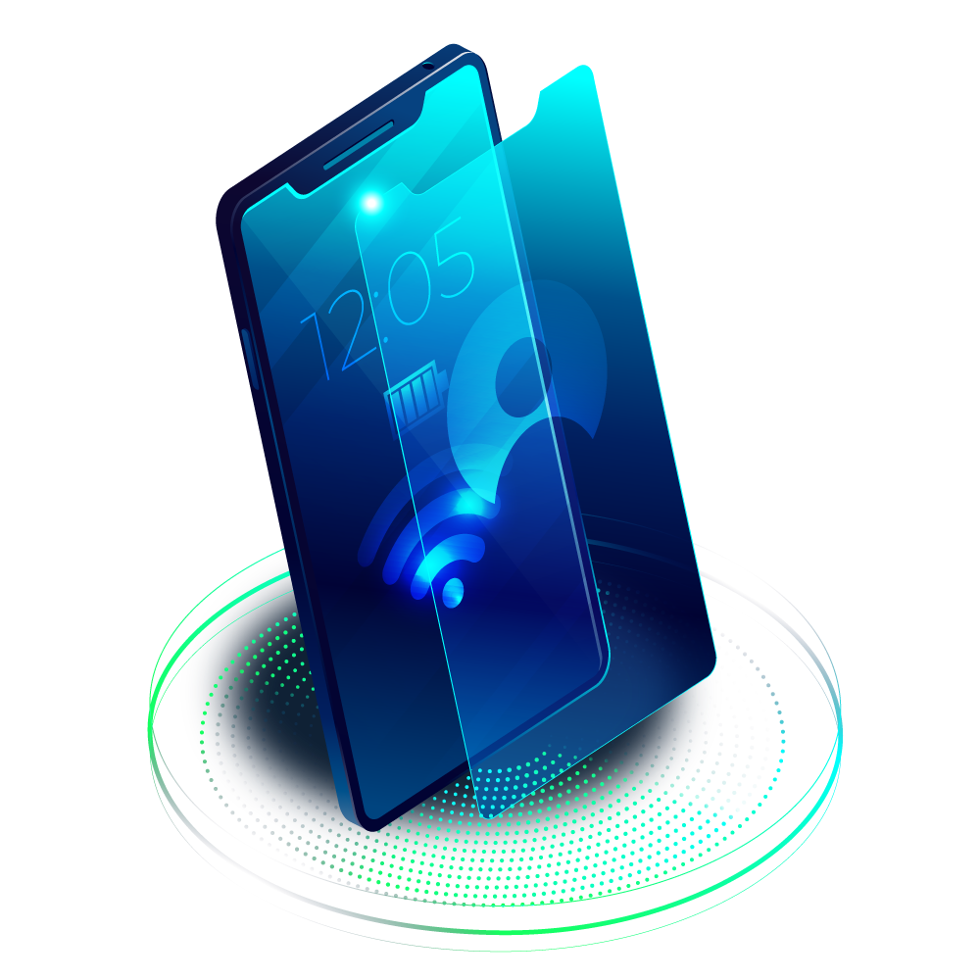
TECHNICAL APPROACH
The whole System having Arduino to interface the sensors. The device is useful for accessing the quality of water. We are presenting a design and development of a cost-effective system for real time water monitoring. The device can measure other physical and chemical properties of the water. The Apparatus consist of modules Water Temperature, pH sensor, Temperature sensor for surrounding & Turbidity Sensor. All sensors are connected with Arduino, it converts the signal form into system readable form and send it to WIFI module. The WIFI Module will send the sensed data to cloud through Bolt platform.

Slide 5
PROBLEM WE ARE ADDRESSING
The main problem that this project addresses is the level of purity and safety a targeted river body can offer at a given time frame.
IS THIS AN IMPORTANT PROBLEM?
The human civilization is based on water bodies. So, it’s necessary to carefully monitor them and take required steps to solve the problem identified.

Slide 6
HOW IT RESOLVES THE ISSUE?
The paper solves the problem of unpredictability of water bodies by constantly monitoring them and alerting the user when a problem is identified.
KEY CONTRIBUTIONS
It provides a systematic real time data analysis
It provides remote access and automated eco friendly management of water bodies
It generates data that could be used to infer key knowledge about the water body via data mining.

Slide 7
COMPONENETS
BOLT WIFI MODULE
ARDUINO UNO
BREADBOARD
LED’S
LCD 16x2
9V BATTERY
JUMPER WIRES
HC-SR04 ULTARSONIC SENSOR
LM35 TEMPERATURE SENSOR
DS18B20 TEMPERATURE SENSOR
pH SENSOR
TURBIDITY SENSOR

Slide 8
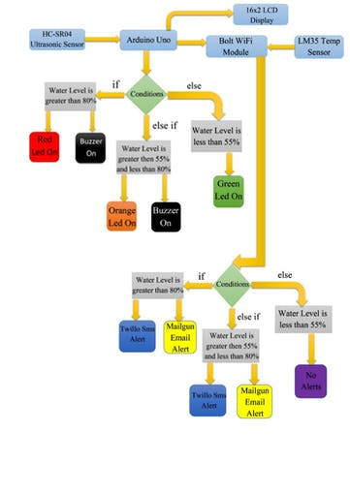
FLOW CHART FOR WATER LEVEL

Slide 9
STRENGTHS
Real Time Monitoring
Alerts via both SMS and Mail
Economical than many present methods

Slide 10
WEAKNESSES
Requires a power-source all the time
Can’t really depend on ultrasonic sensor because it might sense other objects between the sensor node and the water surface.
Turbidity, pH and TDS values of the water body are greatly effected by the rain and flow of fluids into the body. So, it’s not possible to hold fixed threshold values all the time

Slide 11
FUTURE SCOPE
02
Switching to a completely based Solar-Powered solution
To use rain sensors and machine learning to actually predict the time-frame of floods
01

Slide 12
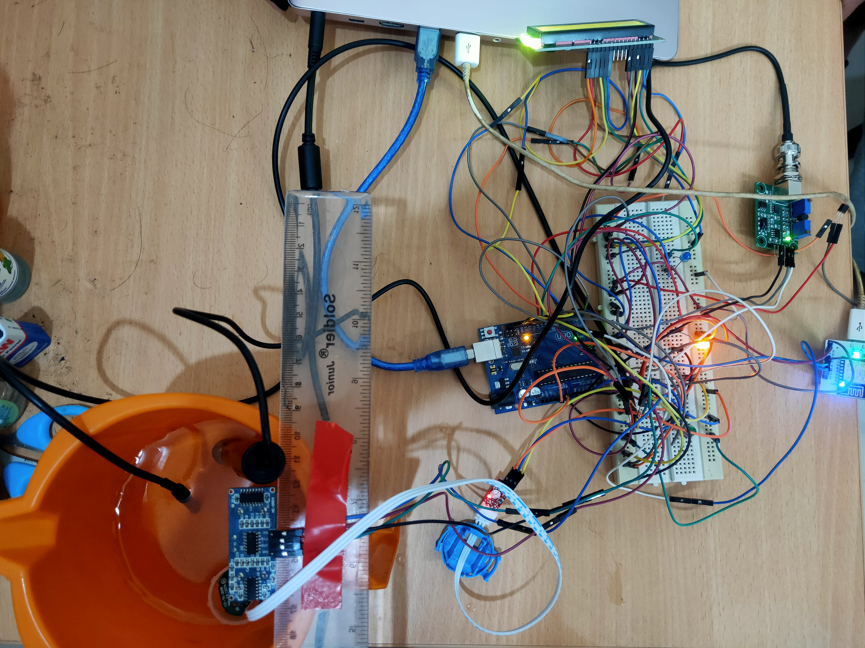
THE PROTOTYPE

Slide 13
THANK YOU
MENTORED BY : DR. RAJESH INGLE
DONE BY
POLISETTI VINAY KIRAN(211000037)
ANIRBAN BHATTACHARJEE(211000010)
AMRIT GUPTA(211000008)

